Slide 1
DISTRIBUTED SYSTEMS Principles and Paradigms Third Edition MAARTEN VAN STEEN ANDREW S. TANENBAUM Chapter 1 Introduction Many modifications by Clark Elliott

Slide 2
This lecture is copyright by Clark Elliott 2020
All rights reserved
This lecture may not be copied, distributed or presented electronically without express written permission.
Copyright 2020 Clark Elliott

Slide 3
CDK
Some slides are courtesy of Coulouris, Dollimore, and Kindberg
Distributed Systems, concepts and designs
This is a good alternative book, and can give you a different perspective on the material.
Copyright 2020 Clark Elliott

Slide 4

Keep your toolbox open this quarter…
We will fill it with distributed systems techniques and tools during each lecture.
Imagine you are in a room full of professionals. What expertise do you bring to the discussion because of your distributed systems background? Can you teach the concepts?
Copyright 2020 Clark Elliott

Slide 5
Two themes throughout the quarter
There is almost always a compromise. Having distributed systems expertise means knowing the best compromise to make. Relevant to distributed system design.
There is no global clock for coordinating processes which affects the choice of algorithms in a distributed system.
Copyright 2020 Clark Elliott

Slide 6
Add to your professional toolbox:
Looking at the big picture, identify the pros and cons of the compromises being made in your distributed systems design.
Copyright 2020 Clark Elliott

Slide 7
We will use a limited definition of Distributed Systems
Software systems that operate on more than one computer via:
Internet
Intranet – like internet but managed by autonomous organization
Mobile computing
Wireless and other modern ad hoc network technologies

Slide 8
Valid Distributed Systems areas, but we will not study…
Parallel computing
Grid computing
Cluster computing
Distributed operating systems
[shared memory systems—brief discussion]
[Distributed algorithms—touch on these]

Slide 9
Distributed System—first view
A distributed system is:
A collection of independent computers that appears to its users as a single coherent system.

Slide 10
Societies = distributed model
People work in societies, and understand them.
Why not software?
The rise of agents—maintain their own state and goals
The rise of autonomous agents—especially as computers and programs become more intelligent and capable of independent decisions.
The human brain is coming online as processing nodes in computer networks, with brain/machine interfaces

Slide 11
We’ll include intranets in our discussions
Like internet
Locally administered
Boundary allows policy enforcement, including for security
Firewall might allow/disallow packets based on remote source or content
Possibly connected to Internet via router

Slide 12
What is a process?
A process is the basic engine of work on a computer system. A process is a computer program that is being executed.
This is true in local systems with all processes running on a [single] central processing unit (CPU).
It is also true in a distributed system, where processes may run on different, network-connected CPUs.

Slide 13
One program can run in many processes at the same time, such as when you start up multiple instances of a browser on your PC.
The CPU of a computer system runs the instructions of a process one at a time, in order.
Processes use resources, such as memory, disk space, printers, displays.

Slide 14
Distributed processing
In a distributed system, many processes many work together to implement one multi-processing program design.
Client/Server programs—one process for the server and (possibly) many processes for the clients.
Peer-to-peer systems—many like processes cooperating together.
We will implement a number of such programs this quarter.

Slide 15
Threads vs. processes
Processes are complex and “resource intensive” entities. They have unique process IDs, their own memory, their own security controls, their own access to file structures, their own accounting and so on. They are scheduled in the CPU as first-class entities.
Threads (of execution) typically share the memory of one process. User threads are managed by the process itself. They are less powerful and less expensive to create and destroy.

Slide 16
In general, consider threads this way…
Processes are separate threads of execution on the hardware and to the operating system.
User threads look to the programmer like they are separate threads of execution. But under the hood they are all still part of the same process.

Slide 17
In general, consider threads this way…
An application programmer with no access to the operating system processes could always re-write a multi-threading program without the user threads and still get the same behavior.
She could not do the same with a multi-processing program, which relies on operating system support.
However, conceptually we can often think of the two in the same way from a design standpoint—as multiple simulatanious threads of execution.

Slide 18
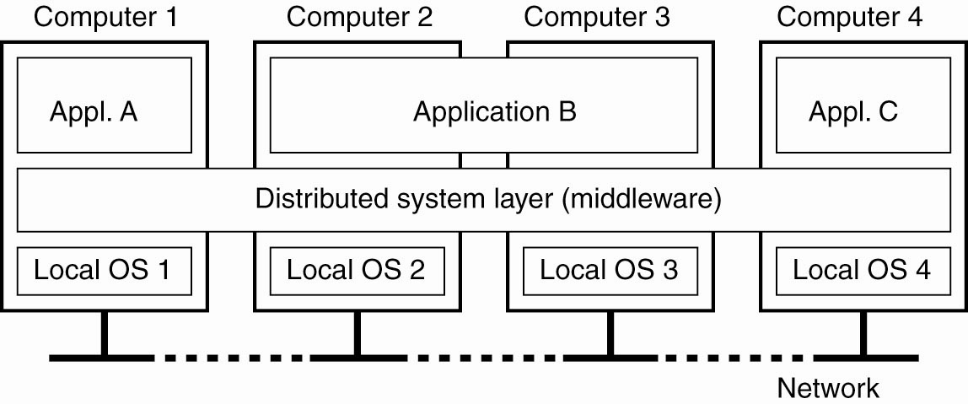
Distributed System—second view
Figure 1-1. A distributed system organized as middleware. The middleware layer extends over multiple machines, and offers each application the same interface.

Slide 19
Open Systems
Non-proprietary system (don’t have to pay for rights)
Publicly known set of interfaces
Anyone can write for, and use the defined standard interfaces to communicate with a system that adheres to the same standards.
The interface is defined, the implementation is open
Encourages development by many independent stakeholders

Slide 20
Open Systems
Interoperability—IDLs define the syntax of the interfaces: names of functions/methods, parameters, return values, exceptions raised on errors, etc.
Semantics is defined differently and elsewhere—the behavior of the services and clients operating through the defined interfaces.
Is your code portable to another installation?
Policy separate from implementation. Runs on PC & Mac

Slide 21
Four requirements
Fully defined, so that all vendors can work within the same framework
Stable over a reasonable length of time, so that the vendors have fixed development targets
Interfaces are publicly available
Are not under arbitrary control of any one firm or vendor.
http://www.businessdictionary.com/definition/open-system.html

Slide 22
IDL – Interface Definition Language
http://condor.depaul.edu/elliott/435/idl/Hello.idl.html
Specify the names of procedures or methods, and the precise bit-streams that go through the interface in each direction.
Require a precise language that can be checked for syntax errors by a program.
Allow any implementation that meets the specifications of the interface.
NOTE—Main purpose is to define the interface, and we could do this using an IDL with pencil and paper. The rest is serendipity for computer scientists.

Slide 23
Publish the interface requirements – captured in the IDL –Anyone can write for (either side of) the interface: client side, server side, peer-to-peer.
IDL – rules are so carefully specified that we can actually use them as a language fit for input to a compiler to write helper code (called stubs or skeletons) that gets us started. Methods, arguments, return values are all specified, based on their definition in the IDL.

Slide 24
For $200,000 could you write the code?
You will write the simple server, Xu will write the simple client that allows the user to make twenty simple queries of various kinds of data in your database.
The two of you have pencil and paper only and invent an IDL: Together you write down all the methods, arguments and return values. All the data types are fully defined at the bit level. You also agree on the semantics of what will be retrieved and sent back by the server.
You leave for Hawaii. Xu leaves for Manchester, UK. Each has a photocopy of the sheets of paper.
No communication is allowed. Xu writes in Java, and you write in C++.
At 3:12 AM on June 24th the server and client will come online. Do you want the job?

Slide 25
Policy separated from Implementation
Not only are the interfaces defined, but also the relationship of the parts of the system itself.
We can replace or update either the local system, or the remote system, without affecting the other component.
Note, for example that the programming language we use at either end is not important.
Big picture is clear. Auditing? Politics?

Slide 26
Arguments against…
In many new arenas, start-up costs may run into the tens of millions of dollars. How do we encourage companies to invest if they are not guaranteed a return?
Consider the development of many extremely useful drugs: suppose drug companies were not guaranteed a proprietary patent? A new drug costs $100 million to bring to market. Who would invest in making one without proprietary rights?

Slide 27
Simple IDL example
Name of Remote Procedure:
Hello-IDL-World
Return type of Remote Procedure:
32-bit unsigned integer
Argument one:
32-bit unsigned integer describing the length of argument two
Argument two:
UTF-8 character string of the length contained in argument one.

Slide 28
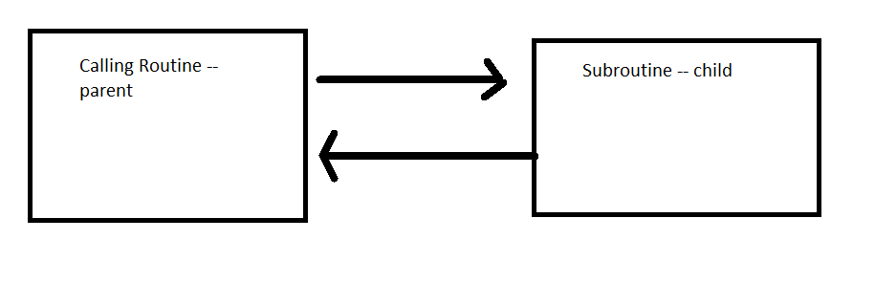
Local Call Sequence

Slide 29
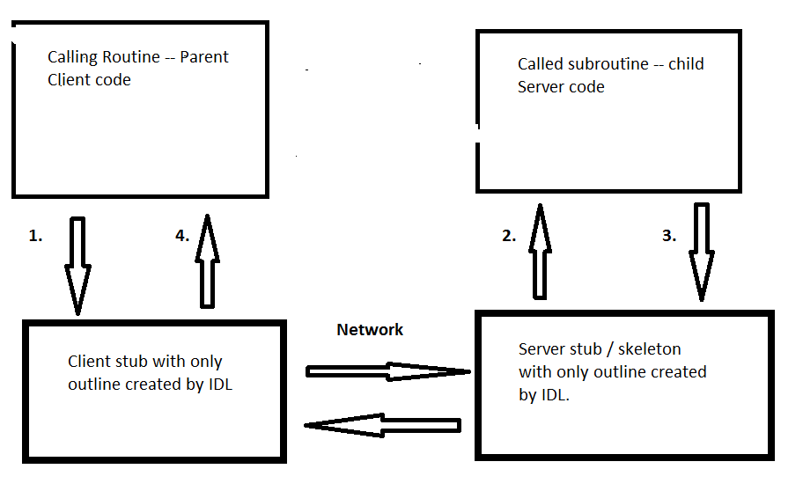
Remote call structured by IDL

Slide 31
Fully Distributed Algorithms
Characteristics of fully decentralized (distributed) algorithms which help with scalability:
No machine has complete information about the system state.
Machines make decisions based only on local information.
Failure of any one machine does not ruin the algorithm.
There is no implicit assumption that a global clock exists.

Slide 32
A formal area of study
Largely research at this point, but valid study of algorithms that are immune to some problems of DSes
We will not study these much. Could be a full quarter class.
However – I do require that you understand their characteristics, and know what they are for.

Slide 33
Scale-up issues in distributed systems
“From your desktop to the web…” Inet!
Size
Geography
Administration – often not discussed

Slide 34
Example: scale-up of online course—size
How many OL students can the server handle?
Bandwidth for the audio visual
Disk space for resources and assignments
Room in the grading links
Etc

Slide 35
Scaling Online class—geography
OL: what happens when OL becomes global?
Timing problems: deadlines are in the middle of the night, fast turn-around email, foreign customs
Suppose there is a lecture on security? DeFacto exportation of “munitions” Ouch!

Slide 36
Scaling problem—administration
Administration is often the overlooked scale-up problem.
The critical issue is that the design of systems must often change rather than just the size of the resources

Slide 37
Example one: online instruction grading
40 OL students: All grade assessments made by one person.
4,000 students: A hierarchical system of graders is now needed.
How do they coordinate? Meetings? Software? Groupware? Consistent responses to students?
How do they agree on edge condition grading?
Need graders, grader-supervisors, grader managers, grader directors.

Slide 38
Example two: systems programmer authentication
Single system: One local system administrator with secret keys to all local resources.
Conglomerate of systems administered non-locally: Have to coordinate among many administrators. This is new.
Now must create and maintain a hierarchy, or set-based system of authentication for system programmers and supervisors.

Slide 39
Administration is not a traditionally algorithm-based structure, so is often overlooked in scale-up discussions.
But because it may require fundamental changes in the structure of the system design it is often the most critical bottleneck in scaling up a distributed system.
As a distributed systems expert, you must know this. Can you explain the concept to a roomful of people?

Slide 40
Add to your professional’s tool box
When discussing current or future scale-up possibilities, have you examined difficulties with scaling up administration?
Do you need to design now for future scale-up with regard to administration?

Slide 41
Recall: Local Call Sequence
Both routines are in the same process, on the same computer:

Slide 42
Traditional blocking (synchronous) calls—works fine with local systems.
Make a procedure call, and the caller does nothing until the call returns.
Millionths of a second to make the call.
If the called procedure fails, the calling procedure is probably failing too because they are typically on the same computer in the same process. If one routine dies, the other dies too.
Because the CPU is busy with the subroutine call it is not available to the caller routine anyway.

Slide 43
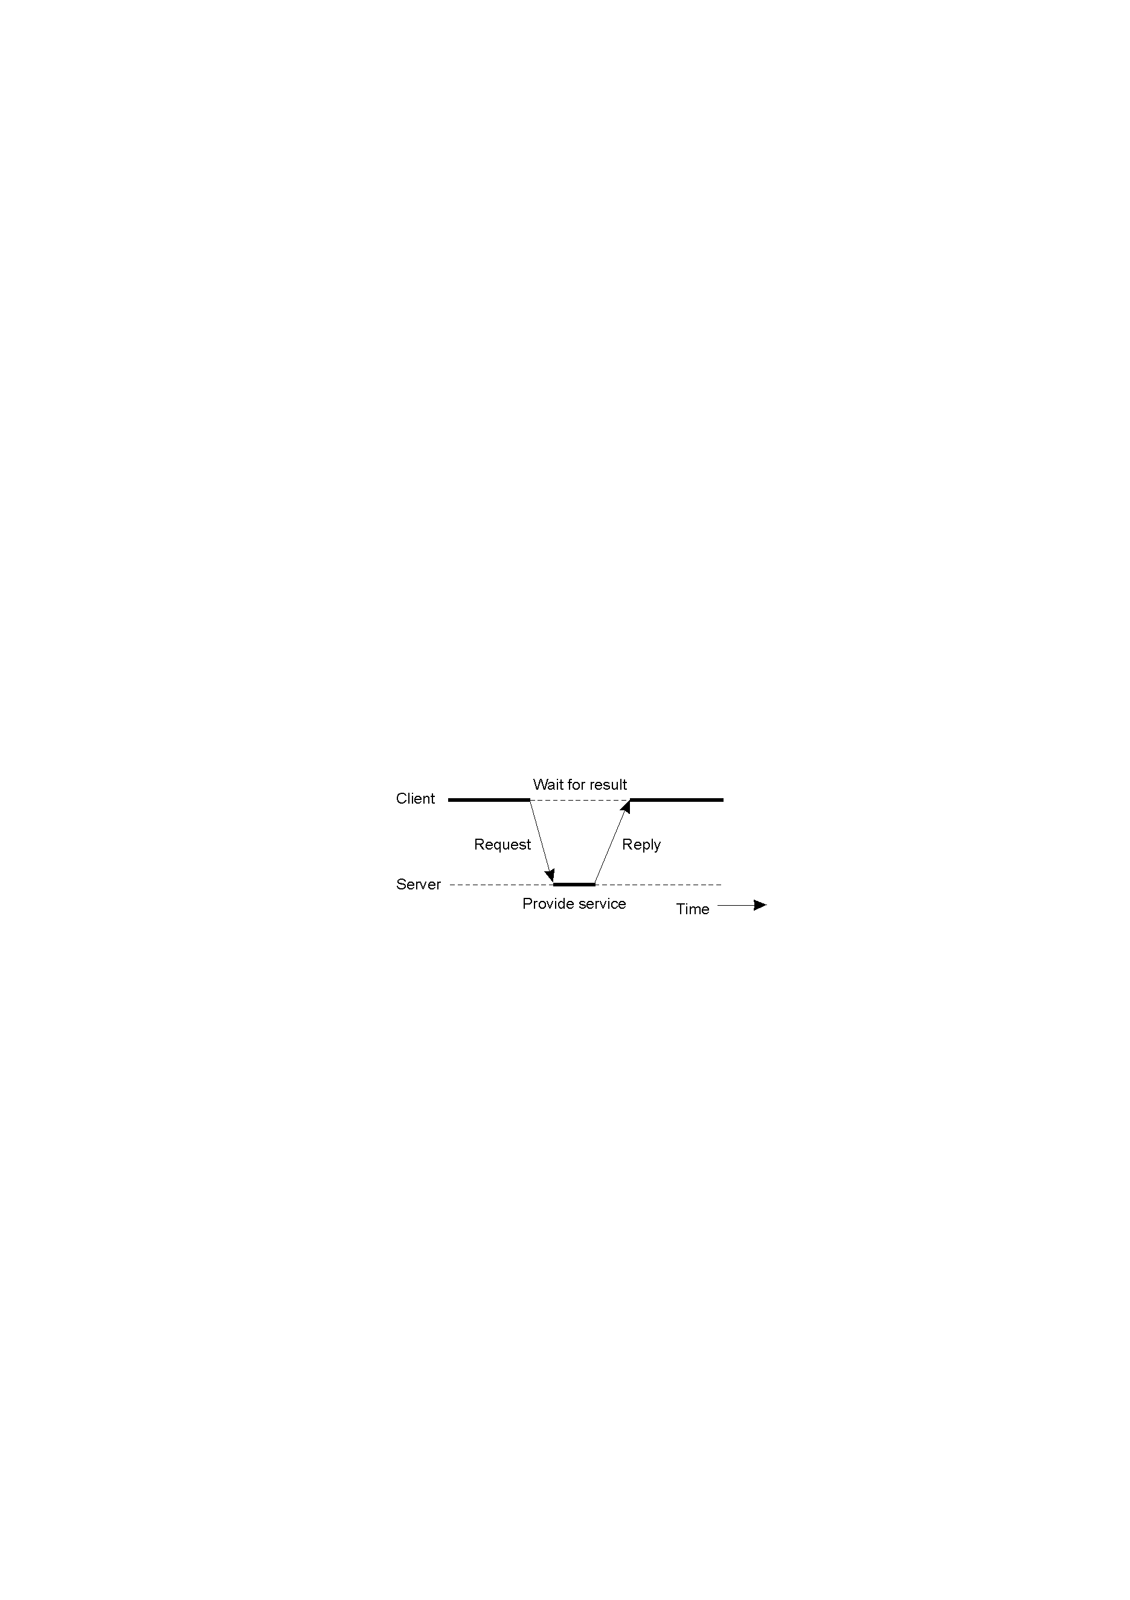
Clients and Servers
Synchronous (blocking) calls between a client and a server are similar to a local subroutine call:

Slide 44
Recall: remote call structure
Calling routine and called routine on different computers:

Slide 45
Traditional blocking calls—problems in a distributed system
Call may take seconds over the network, a million times as slow.
The caller process is blocked waiting and doing nothing, possibly for a long time even though the CPU and memory resources are available.
Geography—more failures because of long network connections.
The called routine on the remote system fails, or the network fails, but the caller routine still alive. It is blocked and can’t query the remote system, or take remedial action (such as finding another server), even though there is no reason for it not to make queries and take actions.

Slide 46
Synchronous vs. Asynchronous
Blocking calls are synchronous—the caller and the called procedure coordinate as though in one process.
A solution is non-blocking, or asynchronous calls
New programming paradigm.
Caller no longer has to wait, doing nothing.
Two processes run at the same time.

Slide 47
Synchronous vs. Asynchronous
Logic is potentially much more complex.
The idea is that the calling process continues, without waiting for the called process to return.
While there is only one type of synchronous call, there are many types of asynchronous calls. We will study these later.

Slide 48
Add to your toolbox
Ask appropriately: should we make the compromise to take on extra complexity with an asynchronous call, so that we can free up our calling processes to:
Get simultaneous work done in both processes at once
Allow the callers to make queries when something goes wrong

Slide 49
Transactions – essential concepts
Before/After: To the outside world there is a before, and an after, and nothing in between. Think of closing on a house: When Jose gets your money, you get the keys to his house. When does the lighting bolt strike?
Critical Section—May have to reserve resources for the duration of the transaction using locks on resources as part of a critical section [CS] of computer code inside the transaction.

Slide 50
Roll back something went wrong, so go back to the before state.
Commit—everything is complete so continue of to other states, possibly discarding all rollback information
Checkpoint—a saved state of the system to which you can return, discarding all subsequent transactions.

Slide 51
The Critical-Section Problem
n processes are all competing to use some shared resource (e.g. writeable data), but only one is allowed access at a time (e.g., for updates).
Each process has a code segment, called the critical section in which the shared resource is accessed (e.g., open the file for update).
Problem: ensure that when one process is executing in the critical section, no other process is allowed to execute in that critical section.

Slide 52
Multiple update example
Ruth and Tom have each loaded into their memory spaces a writable copy of a shared file for updates, which is read only to the rest of the community.
The file reads: “Report on Pastor James Knuth”
Tom adds “The man is a thief and a murderer. Whatever you do, never give this many any money. -Tom”
He saves the file from memory to disk.

Slide 53
Ruth writes, “I had lunch with this very nice man. I gave him my savings to invest with the children’s fund. You should do the same. -Ruth”
She saves the from memory to disk replacing the file that Tom wrote.
The file now reads:

Slide 54
Report on Pastor James Knuth
I had lunch with this very nice man. I gave him my savings to invest with the children’s fund. You should do the same. –Ruth
—We tend to forget all of the complexity that goes on at high speed over the Internet with protocols like those used for Google shared documents.

Slide 55
Semaphores / Memory locations
Semaphores allowing access to a critical section of code:
Usually just an integer memory location. TRUE (not null) means wait, the CS is busy. FALSE (null) means The CS is yours. Proceed.
If the CS is available [Semaphore is FALSE] set the semaphore to TRUE then proceed into the CS.
When you are done, set the Semaphore to FALSE again so others can use the CS.
Local systems have hardware/architecture support for semaphores.

Slide 56
Example Critical Section
Five different bank accounts belonging to two different customers.
As part of a complex transaction move a bunch of money around for escrow, taxes, payments, refunds, etc.
The total money before and after is always identical.
But inside the critical section code you always have to chose to either delete from the sender account or add to the receiver first when you move it. So the total changes temporarily.

Slide 57
During the transaction, the bank accounts are locked to all other processes. They cannot read or write those values.
To the outside world there are five accounts before the transaction, and five after the transaction. There is no access at all during the processing of the critical section.
Why?
Answer: during CS processing we may temporarily violate system invariants*

Slide 58
Characteristic properties of transactions:
Atomic: To the outside world, the transaction happens indivisibly.
Consistent: The transaction does not violate system invariants (rules) when complete.
Isolated: Concurrent transactions do not interfere with one another.
Durable: Once a transaction commits, the changes are permanent.

Slide 59
Example invariants
The age-in-years field may not exceed 120 when the transaction is complete.
All the data must be sorted alphanumerically when the transaction is complete.
*The total money in the system must remain at a constant value.
(Invariants may be temporarily violated within the critical section, during the execution of the transaction, as long as the external world cannot access them.)

Slide 60
Example transaction
Transfer Sam’s money from checking to savings:
Remove $3,000 from Sam’s checking account.
Add $3,000 to Sam’s savings account.
During the process, there is a time when there is a missing $3,000 in the bank. What if the system fails at exactly that moment, then restart outside the transaction? We violate the invariant that the total must remain constant.
The business model requires a transaction: before and after, but nothing in between

Slide 61
Distributed Transactions
Built-in hardware support for critical sections is not available.
The sending of messages is unreliable, and abort messages can go missing as well.
Much more complex than local transactions
But we still need them!

Slide 62
Bank revisted.
Five accounts are maintained by five different servers at five different banks in a distributed system.
We must lock the accounts in five different databases on five different computers, managed by at least five different processes.
Communication is by messages that travel over the network.

Slide 63
Coordination messages can get lost.
Abort messages can get lost.
Commit messages can get lost.
Rollback messages can get lost.
Most important: where is the memory location for the semaphore managing the critical section? On which machine? Managed by which process? Answer: there is none because processes don’t share memory.

Slide 64
Real world example
Getting a plane ticket, a hotel, and a rental car at the Orbitz online travel service.
The transaction manager has to communicate with three separate databases, on three separate computers, managed by three separate processes.

Slide 65
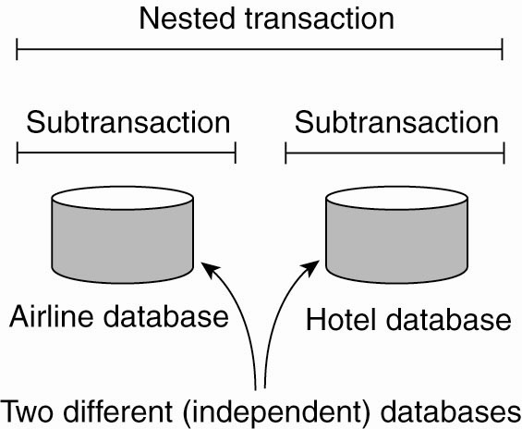
Transaction Processing Systems (3)
Figure 1-9. A nested transaction.

Slide 66
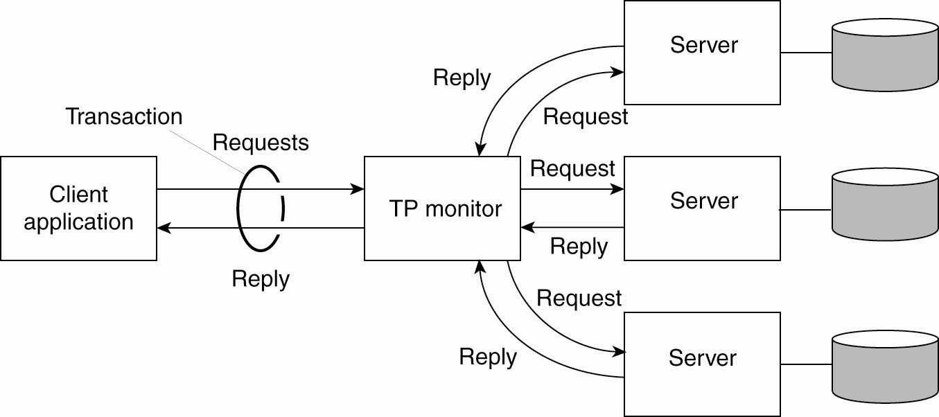
Transaction Processing Systems (4)
Figure 1-10. The role of a TP monitor in distributed systems.

Slide 67

Add to your toolbox
Absolute, crystal clear understanding of what a transaction is, and why it is much more complex in a distributed system.
Be able to explain distributed transactions to a roomful of people.
Understanding that there is hardware support for semaphores on a local system, but only software support via messages among processes in a distributed system.

Slide 68
DISTRIBUTED SYSTEMS Principles and Paradigms Third Edition MAARTEN VAN STEEN ANDREW S. TANENBAUM Chapter 1 Introduction Part II

Slide 69
This lecture is copyright by Clark Elliott 2020
All rights reserved
This lecture may not be copied, distributed or presented electronically without express written permission.
Copyright 2020 Clark Elliott

Slide 70
Inter-process communication
On a local system, processes communicate (share program variables) through shared locations in memory, using Inter-Process Communication (IPC).
In distributed systems, when IPC is not available, processes must send messages over the network.

Slide 71
Shared memory?
The perfect communication solution. No need for this class.
A very simple coordination mechanism between processes
IPCs (Inter-Process Communications) are used to communicate between processes through shared memory. One writes, the other reads, then vice versa.
In distributed systems because we do not have some emulation of shared memory we have to send messages over the network.

Slide 72
Context switching
On a multi-tasking computer, one central processing unit (CPU) is shared by all processes.
[Example: in Windows, run taskmgr]
Processes are continuously swapped in and out of the CPU so that every process gets a chance to run for a while. This is called context switching.
The operating system process managing context switching may switch a process at any time.

Slide 73
Atomic Action
The unit cannot be broken down further. Derives from the idea of an atom, which at the time of discovery was believed to be the basic building block of the universe.
For application systems, this means that any process will be allowed to complete an atomic section of code as though it were never swapped out of the CPU and superseded by another process, or interleaved with another process at the software level.

Slide 74
The critical section coordination problem
Look at semaphore (“gatekeeper”). If TRUE (busy) then return to A, else if FALSE (free) then just continue
Set the semaphore to TRUE
Complete the Critical Section (CS)
Set semaphore back to FALSE
Process X completes step A, then is swapped out
Process Y completes through step B and enters CS, then is swapped out
Process X continues with step B, and also enters CS. Big trouble—two processes are in the CS at the same time!
Tanenbaum & Van Steen, Distributed Systems: Principles and Paradigms, 2e, (c) 2007 Prentice-Hall, Inc. All rights reserved. 0-13-239227-5

Slide 75
Test and Set hardware instruction example
Look at semaphore. If TRUE (busy) then return to A else if FALSE AND SET TO TRUE (was free – now busy) then…
Complete the Critical Section
Set semaphore back to FALSE
Process X completes to B, then is switched out
Process Y loops to A continuously
Process X switched back in, completes CS, and C
Process Y completes CS and C– all is well.
Tanenbaum & Van Steen, Distributed Systems: Principles and Paradigms, 2e, (c) 2007 Prentice-Hall, Inc. All rights reserved. 0-13-239227-5

Slide 76
Multiple update example revisted
The file reads: “Report on Pastor James Knuth”
Tom loads the file for update and sets the semaphore to true (wait).
Ruth attempts to load the file into her memory, but has to wait until the semaphore indicates the CS is available.
Tom adds “The man is a thief and a murderer. Whatever you do, never give this man any money. -Tom”
He saves the file from memory to disk.
He sets the semaphore to false (proceed).

Slide 77
Ruth is now freed from her wait loop, sets the semaphore back to true (wait) and loads the file into her memory.
Ruth writes, “Oh my goodness. I had lunch with this very nice man. I gave him my savings to invest with the children’s fund. Based on what Tom says, you should never do the same. -Ruth”
She saves the from memory to disk extending Tom’s edits.
The file now reads:

Slide 78
Report on Pastor James Knuth
The man is a thief and a murderer. Whatever you do, never give this man any money. -Tom
Oh my goodness. I had lunch with this very nice man. I gave him my savings to invest with the children’s fund. Based on what Tom says, you should never do the same. -Ruth

Slide 79
Monitors in DSes. Hey—where’s my hardware support?
Locked / shared resources, may be on a remote machine.
They may involve processes on different machines with different memory spaces—no test and set!
This is relevant to transactions and distributed transactions.
Usually requires a process to monitor the shared resource. Monitor processes can fail.
Dead processes locking a resource can be a big problem, especially on a remote machine.

Slide 80
Universally Unique Identifiers (UUIDs / GUIDs)
Some character string (or number) that no one else in the universe will ever use.
URLs are UUIDs: One subnet, one machine, [one user], one directory, one file. This is a unique physical path on earth. XML uses this feature to create unique names.
A very large random number will be pseudo-unique and often good enough. E.g., for a universe of a thousand processes, a random number between zero and a trillion will have a conflict only one time in a billion.

Slide 81
A range of numbers can be unique, as long as they are divided up and each range is given to a unique process.
We can also generate a range of numbers large enough for a one-to-one mapping of numbers and all possible current and future real memory locations in all computers on earth.
This would give us a globally shared memory space—we can dream! Regional versions? How fast is the Internet?

Slide 82
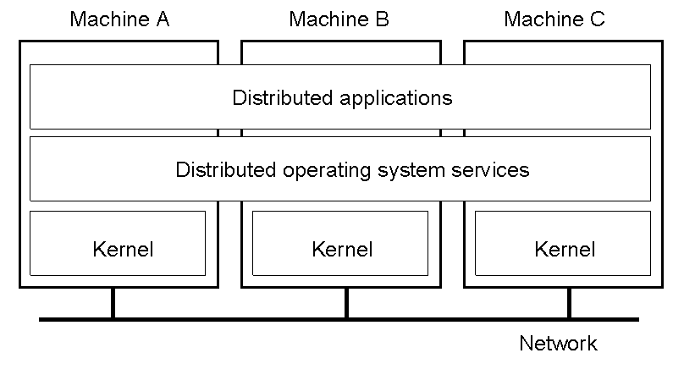
Distributed Systems—where’s my IPC?
General structure of a multicomputer operating system
1.14

Slide 83
The perfect solution: distributed shared memory systems
In theory we could build a universal shared memory system as middleware.
All core memory is mapped to UUIDs which serve as the middleware memory addresses.
Each machine has its own range of UUID memory addresses mapped to local memory.
Any machine in the distributed system could uniquely address the memory space of any other machine without confusion or conflict.
Distributed IPCs could now be used.

Slide 84
But…
WAY too slow and way too buggy
Has to be implemented with message passing among processes “under the hood” anyway.
Impossible to implement in an efficient way.
Requires predicting how programs will run to make it work.

Slide 85
Why study shared memory systems?
Shared memory systems have not proven practical, because they are too devilish to implement (all message passing underneath)
A shared-memory subsystem would solve many of the problems of DS coordination, including that of a global clock.
Useful to consider when trying to understand DS architectures, and what they are trying to provide.
Can we implement part of a shared memory system?

Slide 86
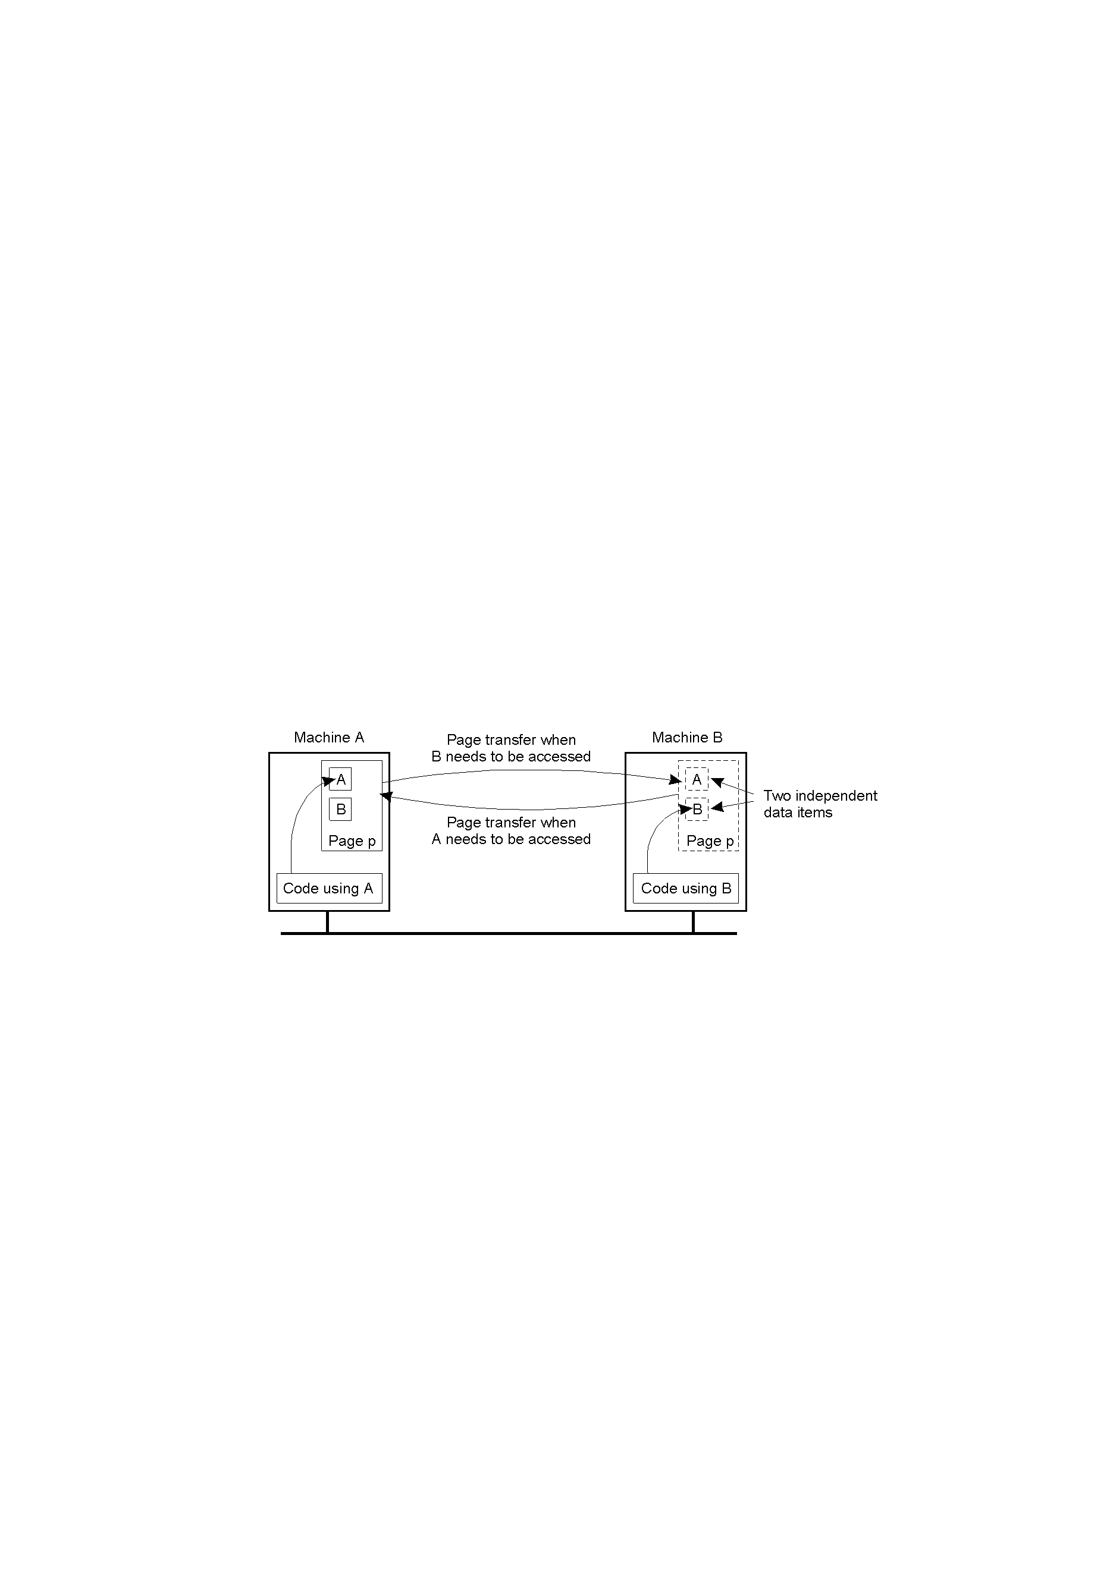
Distributed Shared Memory Systems – an example difficult problem
False sharing of a page between two independent processes.
1.18

Slide 87
What is middleware?
Middleware sits between the application programs, and the operating system library calls and native instructions.
Middleware presents a uniform interface for the application programmer, often (but not always) independent of the underlying operating system.
Berkeley Sockets, Java RMI, CORBA, .NET, RPC, are examples of middleware

Slide 88
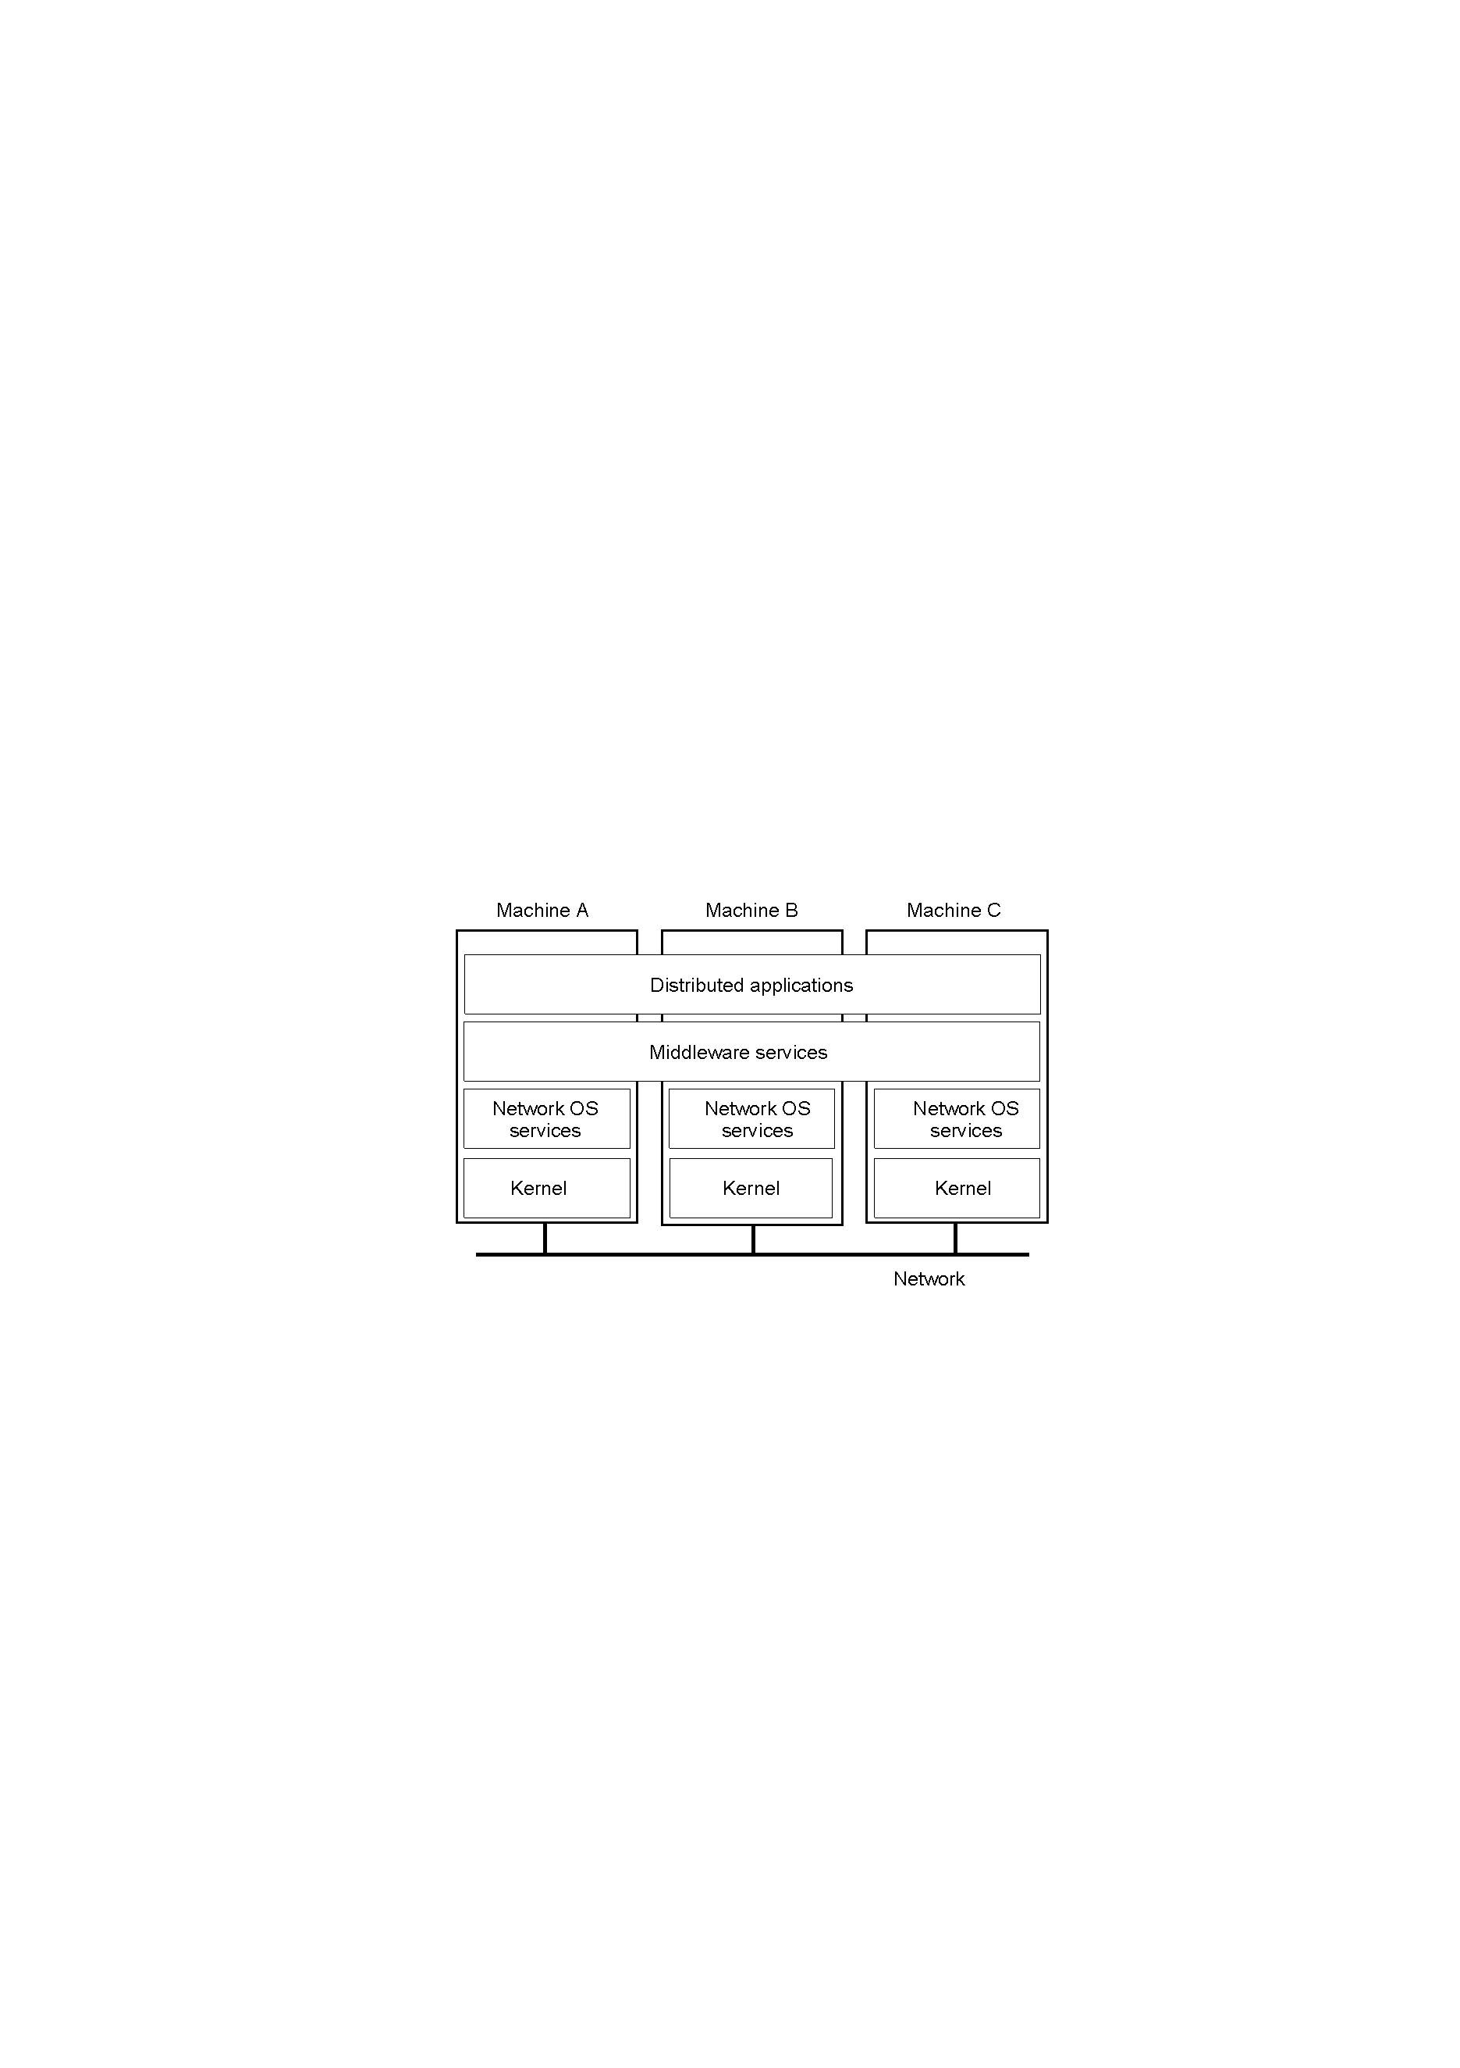
Positioning Middleware
General structure of a distributed system as middleware.
1-22

Slide 89
Usefulness of open systems
In open distributed systems, applications can use one protocol to communicate with other local and remote processes, independent of the operating system on which they are running.
The underlying operating system calls, buffering, network protocols, etc. are hidden from the application programmer who works through an interface.

Slide 90
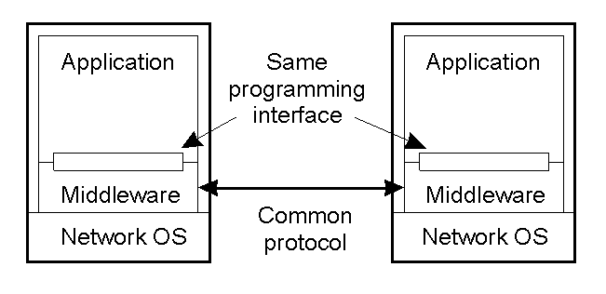
Middleware and Openness
1.23
In an open middleware-based distributed system, the protocols used by each middleware layer should be the same, as well as the interfaces they offer to applications.

Slide 91
Message protocol tradeoffs
There is always a tradeoff between reliability and innate efficiency of the message passing protocol
“Send and forget” is (a) the most efficient, and (b) the least reliable. (UDP)
“Guarantee delivery for every message,” is [possibly] the least efficient, and the most reliable. (TCP)
There are many intermediate compromises. (Use UDP to implement portions of a reliable protocol.)

Slide 92
Efficiency
If you don’t care about execution efficiency, then use the most reliable protocol (e.g., the web using TCP/IP) and emphasize programmer efficiency (e.g., JSON / XML).
If you do care about execution efficiency, then implement only what you need, when you need it. But these will use more development time, and be less open solutions. Typically associated with UDP.

Slide 93
Messages
When the basic computing entity is a (possibly remote) set of processes, the essential mode of communication is through messages from one process to another, or from process to many others.
But the sending of messages can be problematic, especially the sending of remote messages.

Slide 94
Some problems with messages
Receiver’s receive buffer is full
Sender can’t wait, but the send buffer is full
The message gets lost
The acknowledgment (ack) gets lost
The message is delayed.
The messages arrive in the wrong order
A process joins a group, but the broadcasting process doesn’t know it
Coordinating messages cross in transit.

Slide 95
RPC / RMI / etc. → MOM
Problems using send/receive
Sender and receiver have to be active
Sender and receiver have to know each other’s address or endpoint
Buffering concerns must always be considered.
Push toward MOMs that handle some of these problems.
Trade control and efficiency for convenience

Slide 96
Coordination of Processes
Messages are the coordination mechanism for cooperating processes.
Some coordination problems occur over and over again in many types of distributed applications.
Many of these problems have been formalized, and have formal solutions.
Blocking, buffering, and the reliability of the message protocol are among the concerns.

Slide 97
Producer / Consumer Coordination
Original Problem on single system using IPC:
Producer writes until it catches up with Consumer then blocks
Consumer reads until catches up with Producer then blocks
Assume a circular buffer: when you get to the end of the memory buffer (highest memory address) then you go back to the beginning (lowest memory address) and keep processing.
Concurrent code so both processes can operate at once?

Slide 98
Traditional producer / consumer solution with circular buffer and shared memory pointers via IPC
Writer
Reader
Shared buffer* ReadPtr, WritePtr;
while (TRUE) {
// Wait for reader:
while ([WritePtr + 1] % BUF_SIZE) == ReadPtr) No_Op;
buffer[WritePtr] = produce();
WritePtr++;
if (WritePtr == BUF_END){// loop back
WritePtr = BUF_START;
}
}
Shared buffer* ReadPtr, WritePtr;
while (TRUE) {
// Wait for writer:
while (ReadPtr == WritePtr) No_Op;
consume(buffer[ReadPtr]);
ReadPtr++;
if (ReadPtr == BUF_END){//loop back
ReadPtr = BUF_START;
}
}
ReadPtr and WritePtr are shared memory via IPC

Slide 99
Producer / Consumer Coordination in a distributed system.
Problem is that ReadPtr and WritePtr do not live in shared memory so cannot be set/read by the other system.
Producer (on one system) doesn’t know when to stop producing. Consumer (on a different system) doesn’t know when to stop reading.
So where do you coordinate your reading and writing?

Slide 100
Coordinating with a Distributed System
Block sender until send buffer not full
Block sender until local network subsystem sends the message buffer
Block sender until remote network subsystem receives the message and sends ack.
Block sender until consumer application processing queue receives message and sends ack.
Block the sender until the application actually starts processing the request and sends the ack.
Etc.

Slide 101
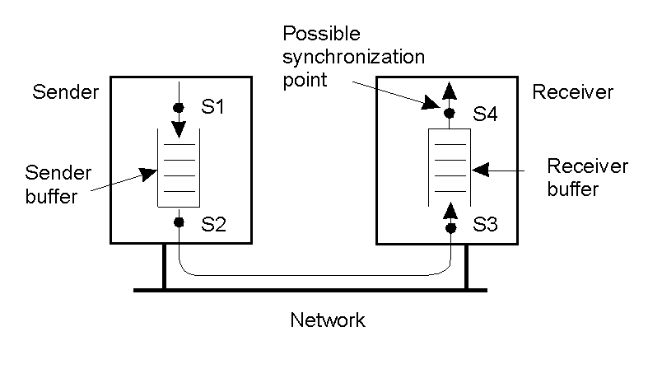
Process coordination w/ msgs
Alternatives for blocking and buffering in message passing.
1.15

Slide 102
Asynchronous calls—Many styles!
There is one kind of blocking (synchronous) call: send the message, then block waiting until you get a return message.
There are many kinds of asynchronous calls.
Minimally, send and forget… move on immediately.
Maximally, wait until the server application actually starts work on the request.
Every variation in between.

Slide 103
Asynchronous calls—complex
In addition to all the complexities of determining when you release the caller to go about its work…
When the result is ready on the server, you must now interrupt work back on the client to receive it.
Typically the client must maintain a “results server” to receive the result into a buffer. The client has to check periodically and branch to handle it. So the client must also be a server!

Slide 104
False assumptions made by first time Distributed Systems developers:
The network is reliable.
The network is secure.
The network is homogeneous.
The topology does not change.
Latency is zero.
Bandwidth is infinite.
Transport cost is zero.
There is one administrator.

Slide 105
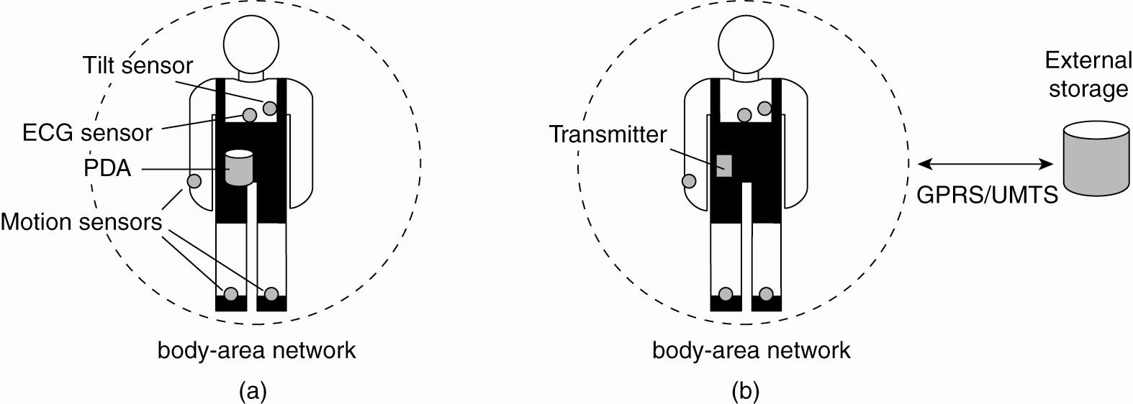
Electronic Health Care Systems (2)
Figure 1-12. Monitoring a person in a pervasive electronic health care system, using (a) a local hub or
(b) a continuous wireless connection.

Slide 106
DS questions for wearable EHC systems
What are the tradeoffs? Which design minimizes losses and maximize the gains?
What are the priorities?
What are the absolute constraints? Health? Legal? Costs?
These are different questions. All may have to be addressed algorithmically

Slide 107
Where and how should monitored data be stored?
How can we prevent loss of crucial data?
What infrastructure is needed to generate and propagate alerts?
How can physicians provide online feedback?
How can extreme robustness of the monitoring system be realized?
What are the security issues and how can the proper policies be enforced?
What are the relative costs of different systems, now and as maintained?

Slide 108
Data stored at the hospital server—pros
Professional security and backups—it’s our job to manage the data.
Easy data aggregation for e.g., AI systems (AI doing a better job now than highly-trained radiologists for some applications.)
Regular upload of data means little loss from patient error (they drop the body device in the bathtub).
Continuous monitoring of the patient and can inform an M.D. of emergency circumstances.
Outside of network connectivity, the end-user device is cheap and simple.

Slide 109
Data stored at the hospital server—cons
Legally responsible for the data
Potentially catastrophic breaches of privacy on a large scale.
Must maintain a regular connection with the end-user (patient) requiring reliable connection. Not always possible in rural areas, or in third-world countries.
During network outages, the patient is at risk.

Slide 110
Data on the patient device—pros
Patient is entirely responsible for keeping the data safe. Complete legal deniability by the hospital if the data is not stored at the hospital.
Intelligent device can process the data locally and signal emergency conditions immediately even without network connectivity.

Slide 111
Data on the patient device—cons
Intelligent device is more expensive to purchase and insure.
Intelligent device becomes a legal issue regarding correct signaling of emergency conditions.
Ill, often elderly, patients should not be in charge of keeping data safe from privacy leaks, data loss, catastrophic equipment failure from misuse (e.g., dropping in the bathtub).
Expensive devices may be stolen or lost.
Data has to be regularly uploaded by the patient, a questionable roll.

